Slide 1
Plagiarism
Checker
Presented By : Gaurav Gunjan
Course: BCA (AI & DS)

Slide 2
Objectives
1
Apply OOP concepts in C++
Read and process text files
Tokenize and normalize words
Compare documents for similarity
Display results with clear statistics

Slide 3
OOP Concepts Used
2
Class & Objects → Document, TerminalRenderer
Encapsulation → Private data (filename, content, words)
Abstraction → Public methods (getWords(), getWordCount())
Modularity → Separate responsibilities (Document handles data, Renderer handles output)
Reusability → Functions like normalizeAndTokenize()

Slide 4

Main Function Workflow
3
Print header
Validate arguments (argc < 3)
Load documents (Document doc1, doc2)
Check if empty
Compare unique words
Calculate similarity:
$$\text{Similarity}=\frac{\text{Matched} \text{Words}}{\text{Union} \text{of} \text{Unique} \text{Words}}×100$$
Display matches, stats, and verdict

Slide 5
Example Output
4
Header: PlagCheck banner
Common Words: List of matches
Statistics: Word counts, unique words, union
Final Score: % similarity
Verdict: High / Moderate / Low / Minimal plagiarism

Slide 6
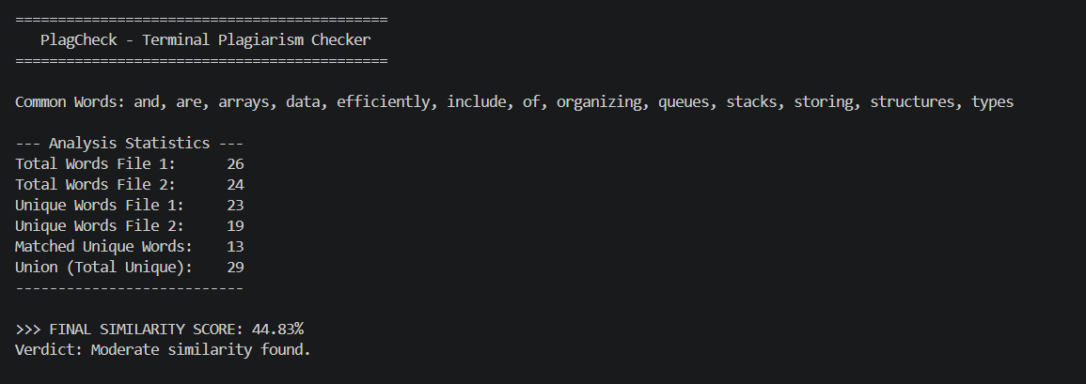
Example Output
5

Slide 7
Conclusion
6
OOP in C++ makes the plagiarism checker structured, modular, and reusable
Combines file handling, string processing
Practical example of encapsulation + abstraction
Ready for extension into GUI or web-based checker

Slide 8
Thank
You !!

